Slide 1

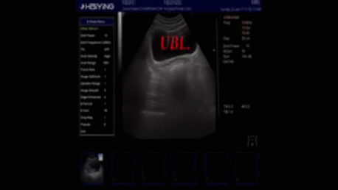
The Role Of Ultrasound In The Assessment Of IUCD
Dr Muhammad M Al Hennawy Ob/gyn consultant
Dumyat specilised hospital,raselbar central hospital mmhennawy.site44.com

Slide 2
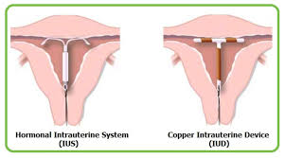
IUCD or IUCS
It is a small, flexible, plastic device
Either
Intrauterine contraceptive device(IUCD) which contains metal e.g. copper ,silver , gold , steel
or
Intrauterine contraceptive system(IUCS ) which contains hormones e.g. progesterone Or medicine e.g.indomethacin
and
Is inserted into the uterus
To prevent pregnancy.

Slide 3

To IUD or not IUD? That is the question..
Intrauterine contraception is highly effective, very safe, and generally well tolerated by most women.
As such, it has become an increasingly popular method of contraception.
Despite the overall excellent safety profile, side effects and complications can occur at the time of insertion and at different time points following insertion.

Slide 4
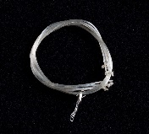
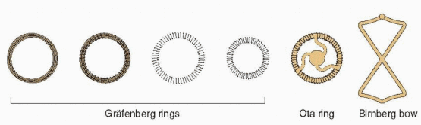
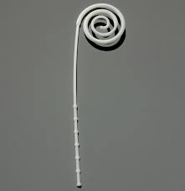
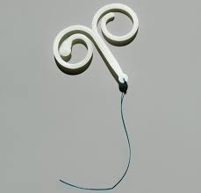
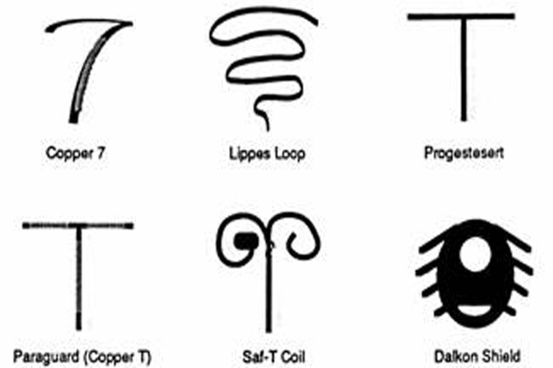
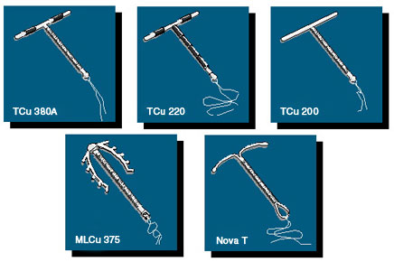
Short History Of IUCD
1909 Dr Richard Richter ( germany) : dried silkworm gut
1923 Dr Karl Pust (germany ) :similar device with tail
1929 Dr Ernest Grafenberg (germany) : Grafenberg rings
1934 Dr T.A. Ota (japan ) :ota ring
1960 Dr Lazar Margulis (usa) :margulies spiral
1962 Dr Jack lippes(usa) : Lippes loop(gold standard)
After that : Birnberg "BOW“, the safety-coil and the Dalkon Shield
1971 the copper-containing by Jaime Zipper (Chile) : The Cu-7
1974 TCu 200 IUD
1976 progestasert (usa)
1988 Paragard 380 A
Nova T and Multiload
2001 Mirena ( levonorgestrel )
Future IUCD : Frameless Iucd eg. (With copper ) Gynefix or ball and with progesterone eg. Fibroplant and other new framed iucd

Slide 5
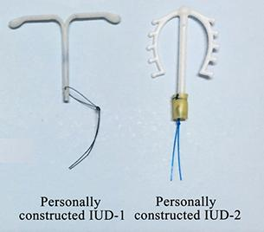
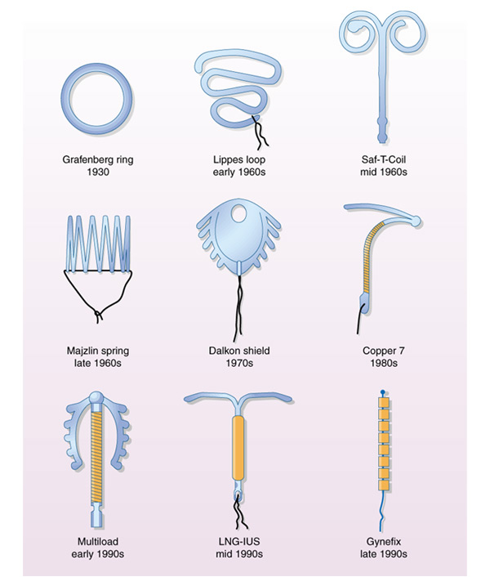
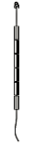
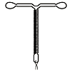
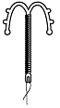
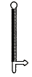
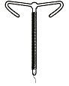
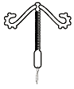
At least six new devices are under development, or have recently been introduced, outside the US.
ICFD | Gynefix | Multiload mark 2 | Soft-T | Fincoid350 | Cu safe 300

Slide 6
IUCD Or IUCS Classifications
First generation : non medicated or inert : margulies , lippes loop
Second generation : copper medicated IUCD: copper 380A , copper with silver (nova T).copper with gold , steel iucd
Third generation : hormonal IUCS : mirena , skyla
Fourth generation : Frameless IUCD (gynefix) , BallI UCD , Frameless IUCS (Fibroplant) , Medicated with indomethacin and others

Slide 7
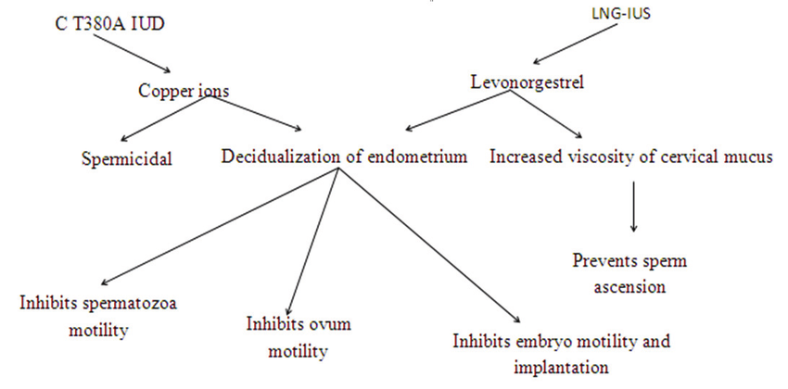
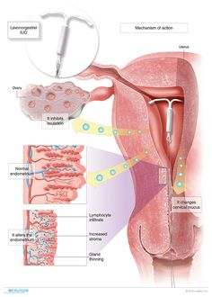
MECHANISMS OF ACTION
The details of all the mechanisms of action of each of the IUDs have not been completely evaluated
It may : -Block sperm from reaching or fertilizing the egg -Make the lining of the uterus unsuitable for implantation. -interfere with the ovulation process We do not know which of these actions is most important for preventing pregnancy and most likely all of them work together.

Slide 8
Contraindications
Absolute Contraindications:
Suspected pregnancy
Vaginal bleeding of unkown cause
PID
Cancer of cervix , uterus and other pelvic tumours
Previous ectopic pregnancies
Relative Contraindications:
Anaemia Hgb < 10 gm/dl , menorrhagia , purulent cervical discharge, Any congenital or acquired uterine abnormality distorting the uterine cavity in a manner that is incompatible with placement of an IUD , fibroids and unmotivated persons

Slide 9
Advantages and the Disadvantages of ( IUD )
Advantages:
- Once inserted, remain in place.
- Remains effective while in place.
- It prevents pregnancy for long period
- Does not interfere with sexual activity.
Disadvantages :
- May cause bleeding and cramping.
- Increased risk of ectopic pregnancy.
- Doesn't prevent sexual transmitted diseases.

Slide 10
Time Of Insertion
During Or After menstruation or at any time during the menstrual cycle
After abortion (spontaneous or elective medical or surgical)
During Or After labour : Both immediate postpartum insertion (within 10 minutes of placental delivery) and delayed postpartum insertion (within 4 weeks of placental delivery)
Emergency within 5 days of the first act of unprotected sexual intercourse as an emergency contraceptive
The World Health Organization and the Centers for Disease Control and Prevention (CDC) have developed guidelines for practitioners regarding IUD use in a variety of clinical circumstances.
IUDs are considered appropriate for the majority of women, including nulliparous women and adolescents.

Slide 11
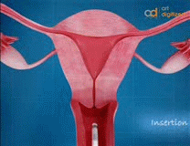
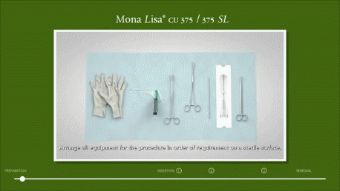
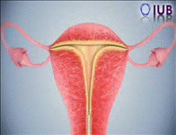
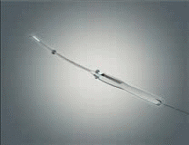
Methods Of Insertions
Multiload
Cut380A
Ball iud
Mirena

Slide 12
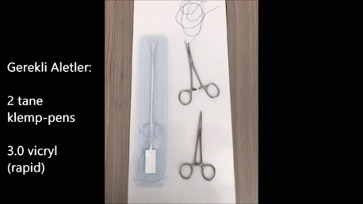
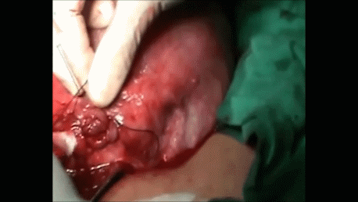
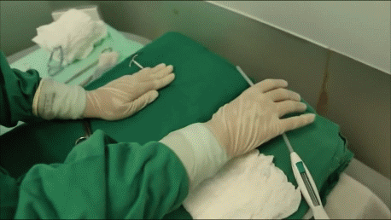
Methods Of PPIUCD Insertions
With threads (Hang up technique)
- From ouside
- From inside
- from inside frameless loop
With knotted loop of 2-0 chromic catgut suture on both transverse arms of the
Without threads
frameless loop
- Anchor method
copper T 380 , Multiload or Mirena
-Manually
- Assisted by ring forceps
- IUCD applicator

Slide 13
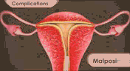
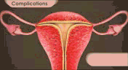
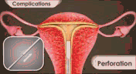
Complications
Bleeding
Pain
Malposition
- Displacement of IUCD that is rotated from the normal transverse position or inferior positioning located away from the fundus and within the lower uterine segment or cervix
- Embedment Partial penetration or embedment of ParaGard® in the myometrium c by the arm or stem of the IUD by the arm or stem of the IUD an make removal difficult. In some cases, surgical removal may be necessary.
-Perforation (partial , complete )
- Expulsion (partial , complete ) either partially or completely through the external cervical os
Migeration IUD might become embedded in the wall of the uterus or slowly migrate completely through the uterine wall. If this happens, the device could possibly damage nearby internal organs.
Pregnancy (intrauterine,extrauterine)
Infection (upper GTI, lower GTI )
Missed threads ( threads torn, threads retracted in cervical canal or in the uterus , embedded , perforation ,migeration , expulsion )
Infertility
IUD Retension a retained IUDor a fragment of IUD is an unusual cause of PMB. Physicians should include a retained IUD inthe differential diagnosis of PMB and should use hys-teroscopy to exam the uterine cavity
IUD fragmentation IUDs may, rarely, be broken during expulsion or removal, including embedded retrieval strings
Calcification
Wilson’s Disease Theoretically, ParaGard® can exacerbate Wilson’s disease, a rare genetic disease affecting copper excretion.
Rarely a vasovagal episode as a result of cervical or uterine manipulation.

Slide 14
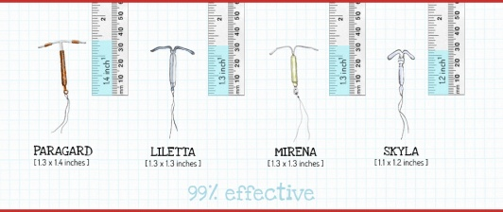
Complications Depend on
Iucd
- Size of iucd ( longitudinal , width ) – decrease size ---decrease bleeding , colic
- Shape of iucd: Frameless IUDs (GyneFix) and Ball IUCDs hold promise as no considerations of uterine width or shape is necessary
: framed devices, provided with shortened transverse arm and IUDs which adapt to the width of the uterus,
- Material of iucd : Addition of copper to inert devices seemed to slightly improve the bleeding
: Hormone-releasing devices appear to reduce the amount of bleeding significantly but a post-insertion phase of irregular spotting is a common complaint
- Flexability of iucd
Doctor
- Trained : Proper insertion
- Apply Infection control
- Time Of Insertion : during the first half of the cycle: pregnancy is almost definitely ruled out but pain and increased bleeding within the first two months , during the second half of the cycle, : insertion is thought to be easier because the cervical opening is more accessible with the less the risk of expulsion and lower risk of infection
. Client
- Age
- Parity
- Associated medical condition ( blood disease, , )
- Uterine cavity shape :As uterine cavities differ considerably in size in all women, and the uterus changes in size and volume during the menstrual cycle, it is unreasonable to expect one standard-sized IUD to fit uterine cavities with different sizes and volumes.
- Direction of uterus
- Duration of use : PID is also reported for women who use the device for more than 5 years.
: the yeast organisms were more prevalent on the IUD tails than in the vaginal mucosa indicates that the IUD tail acts as a reservoir of infection

Slide 15
Imaging Of IUCD
X-ray
U/S
CT
MRI

Slide 16
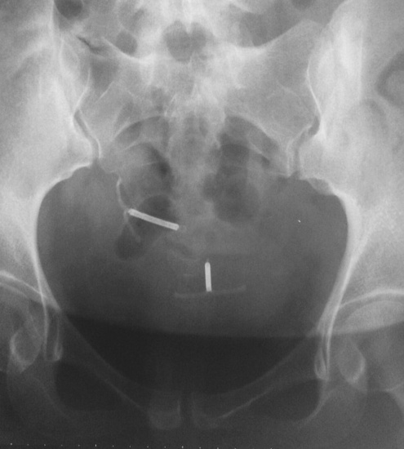
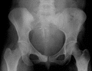
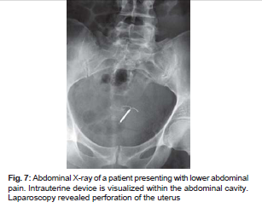
X- Ray
When the IUD cannot be seen on pelvic ultrasonography, abdominal radiographs can be used to evaluate IUD positioning, as all IUDs are radiopaque.
Positioning on an abdominal radiograph varies with normal uterine positions, but the IUD should be located upright in the midline pelvis inferior to the pelvic brim, in the expected location of the uterus
Intrauterine displacement and embedment may have similar appearances at radiography

Slide 17
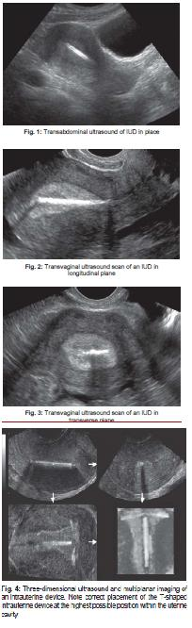
U/S
Ultrasound ( Abdominal or Vaginal)
ultrasound is the preferred modality in assessing an IUCD.
Properly placed IUCD may be visualised as a straight hyperechoic linear structure in the endometrial canal of the uterus and The side-arms that form the “T” are echogenic with copper devices (the Paraguard) but less visible on the levonorgestrel-releasing device (the Mirena) often causes posterior acoustic shadowing..
3D ultrasound
may be useful to help visualise the IUCD location (especially with serpiginous IUCDs

Slide 18
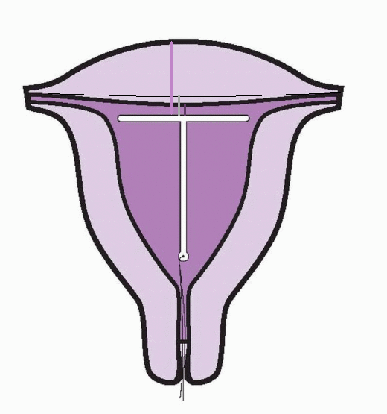
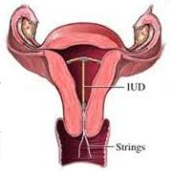
1 -the distance IUD-endometrium, IUD-myometrium, and IUD-fundus were 7, 11 and 27 mm, respectively, among users without complaints. The ultrasonographic diagnosis of the IUD position was unable to discriminate between women who did or did not have complaints of bleeding and/or pain.
2 - the distance from the top of the uterine cavity to the IUCD should be < 3 mm
distance > 4 mm is more often associated with symptoms such as bleeding and pain, as well as with a higher risk of expulsion or displacement
in cases where it becomes embedded, a part of it may be visualised within the myometrium.
3 - if it is located too inferiorly, or if it begins to extend through the internal cervical os, its effectiveness is decreased and may also cause pelvic pain and/or bleeding. It should be repositioned

Slide 19
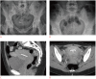
CT Or MRI
In cases where complications such as perforations or abscesses are suspected, computed tomography (CT) or magnetic resonance imaging (MRI) may be a helpful adjunctive modality given their larger field of view.
However, the associated radiation with CT and the cost of MRI limits their utility as a first-line modality for the evaluation of IUD position
Stainless steel IUDs have not undergone testing.

Slide 20
The Time Of Sonar
Before insertion
Continuous during insertion
Immediately after insertion
Follow Up -- As routine
-- When complications occur
-- After ppiucd (intracesarean or vaginal )
Continuous during extraction
After extraction

Slide 21
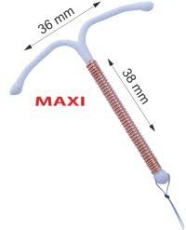
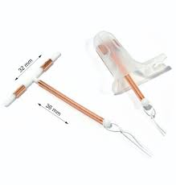
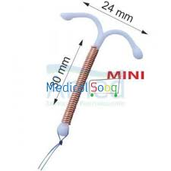
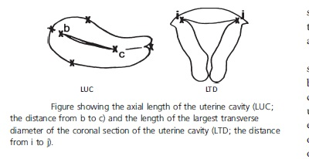

Before insertion
Demonestration of abnormal position of the uterus ( RVF , lateral position )
Demonestration of submucus lieomyoma
Demonestration of uterine congenital anomalies ( bicornuate , septate uterus)
Demonestration of the lengh and width of the uterus
Mean endometrial cavity length was 3.84+/-0.03 cm in nulligravida and
4.25+/-0.03 cm in parous women according to uterine sounding
3.70+/-0.03 cm and 3.84+/-0.03 cm, respectively, according to ultrasonography
mean length of the endometrial cavity was >3.6 cm, the length of the most common IUDs,
the measurement of the normal uterine cavity width and have shown that this width varies with gravidity and parity.
The mean width of the uterine cavity of nulliparous women (27 mm) is narrower than the width of a standard intrauterine device (32 mm), suggesting that physicians should consider ultrasonography to measure the uterine cavity before inserting an intrauterine device.
The length of the uterus can be determined by sounding, which measures the distance
from the fundus to the external os. Since the cervical canal is not the same length in all
women, this measurement of the length of the uterine cavity is not entirely reliable
stem lengths of 32 and 36 mm
and are therefore suitable for wombs with a sounding length of 6 to 9 cm. The low-grade
Multiload Cu 250 Short has a considerably shorter stem length of 24 mm, which makes this
suitable for shorter wombs (which are quite uncommon). It is inadvisable to insert an IUD
into a womb with a sounding length >9 cm

Slide 22
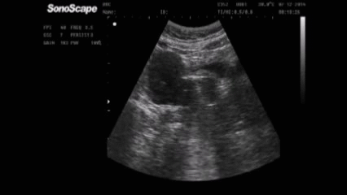
Continuous U/S During Insertion Or Ultrasound Guided IUD Insertion
UD insertion generally requires no imaging guidance.
The IUD is inserted through the cervix using a sheath and is placed at the uterine fundus.
Some circumstances may require US guidance; for example,
if submucosal fibroids are present, US guidance ensures proper positioning within the endometrial cavity.
In addition, if there is high resistance to insertion, US guidance helps prevent uterine perforation.
But both the gynecologist and sonographer must be experienced.

Slide 23
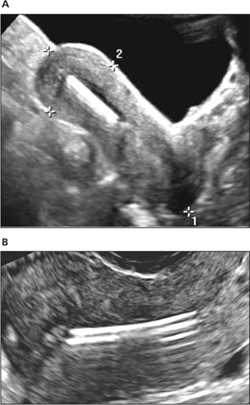
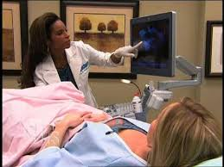
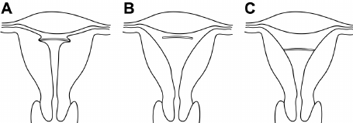
Immediately After Insertion
ACOG: Performance of an ultrasound to check IUD placement is not a common practice to use ultrasound to confirm placement. Therefore, this would not be routinely billed.
Measure Position of misplaced IUD by US at insertion and 2-3 months after insertion
Movement of IUD can be upward or downward, but more commonly upward
2/3 of misplaced IUDs at insertion will move to normal position within 3 months and that ultrasound evaluation of its position is not a good predictor of future evoluation.
But ultrasonography may be used to confirm the location of the IUD when the physician incurs a difficult IUD placement (e.g., severe pain, uterine perforation, etc.).

Slide 24
Follow Up
- As a routine
-When complications occur
- After PPIUCD

Slide 25
Follow up as routine
In the absence of complaints and with the IUD in place, further periodic follow-ups to verify its presence are not necessary.
The woman herself can, if she wishes, check from time to time that the strings can still be felt
The NHG Practice Guideline 'Intrauterine devices

Slide 26
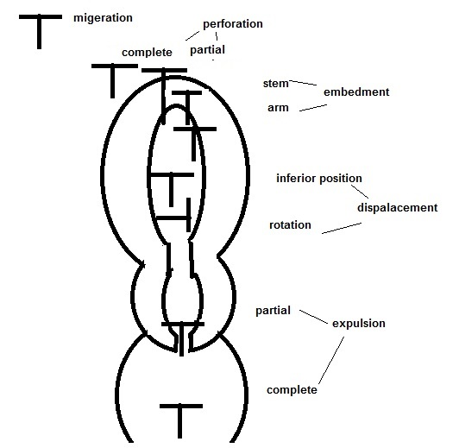
Follow Up As Complicaions Occur

Slide 27
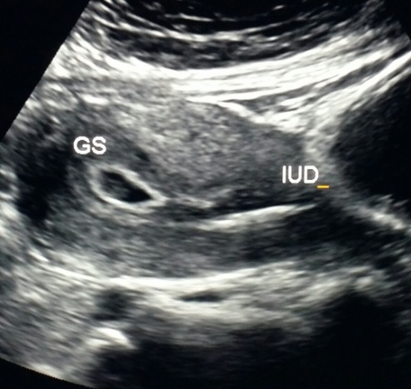
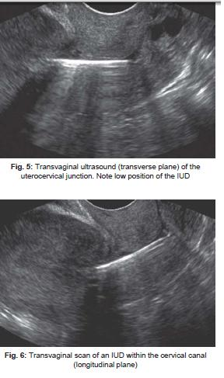
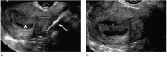
Displaced and embedded intrauterine device (IUD) with early pregnancy in a 24-year-old female with acute abdominal pain and positive pregnancy test

Slide 28
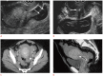
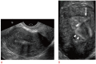
Displaced intrauterine device (IUD) with ruptured ectopic pregnancy in a 33-year-old female having acute pelvic pain.
Embedded intrauterine device (IUD) in a 31-year-old female presents with the absence of retrieval strings.

Slide 29


Partially perforated intrauterine device (IUD) in a 43-year-old female with shortened retrieval strings.
Complete intrauterine device (IUD) perforation with intraperitoneal migration in a 30-year-old female with absent retrieval strings and right upper-quadrant abdominal pain.

Slide 30


Retained intrauterine device (IUD) retrieval string in a 24-year-old female with crampy pelvic pain and history of IUD removal approximately a year ago.
Calcifications associated with the intrauterine device (IUD) in a 39-year-old female with pelvic pain and a history of a levonorgestrel-releasing IUD placed approximately a year ago.

Slide 31
Follow Up After PPIUCD
Immediate postpartum IUD placement has been shown to be safe, and is recommended by the American College of Obstetricians & Gynecologists, the World Health Organization and the U.S. Center for Disease Control.
Immediate postpartum IUD placement has the advantage of providing contraception at a time that the woman is already accessing medical care, avoiding potential loss to follow up or risk of unintended pregnancy. Additionally, women who have anesthesia for delivery have reduced pain at the time of IUD placement compared to having the IUD placed at the postpartum follow up appointment
For research , A transabdominal scan of pelvis was taken with full bladder at 48 hours, 6 wks & 12 wks and 12 months postpartum to assess distance between fundus of uterus and horizontal T-limb of Cu-T
The standard follow up is a string check (speculum exam to confirm presence of strings at cervical os) 2-6 weeks after IUD placement. If strings are not visible, or if the patient experiences symptoms concerning for expulsion, a transvaginal ultrasound will be performed.

Slide 32




Continuous U/S During Extraction
Ultrasound-guided grasping tool IUCD removal when the strings are not visible and conventional office procedures have failed. Using ultrasound , retained intrauterine device with or without strings can be effectively and safely removed in an office-based setting at less cost than in the operating room
Ultrasound-guided hysteroscopy IUCD removal may be a safer option in experienced hands especially during the first and second trimester or in case of failure of previous ultrasound-guided IUD removal in early pregnancy..
Department of Obstetrics and Gynecology, Karacabey State Hospital, Karacabey, Bursa, Turkey (Dr Biyik).

Slide 33
After Extraction
Specially when IUCD is broken or snapped (before or during extraction )
When suspect infection in uterus or tubes

Slide 34









Slide 35



Slide 36

Early IUD removal appeared to improve outcomes in most studies when compared with women who retained their IUDs throughout pregnancy, but did not eliminate the risks.
Insufficient data exist to make conclusions about the unique adverse effects, if any, of the hormonal LNG-IUD on adeveloping fetus and pregnancy outcomes. Future research is
needed to determine whether the timing or method of IUD removal affects pregnancy outcomes

Slide 37


Slide 38

Conclusion
o The routine use of ultrasound prior to, and immediately following insertion of an IUD, including a routine 6 week follow-up ultrasound study is not indicated.
o Indications for ultrasound include the following:
➢ Abnormal pelvic exam prior to IUD insertion, such as pelvic mass, irregularly shaped uterus, or enlarged uterus.
➢ Suspected complication at the time of IUD insertion:
▪ Suspected abnormal IUD position at time of insertion
▪ Suspected uterine perforation
▪ Severe pain immediately following insertion
▪ Excessive bleeding immediately following insertion
➢ Inability to feel or see IUD string following insertion
➢ Failure to improve with conservative treatment such as antibiotics for cramping, light bleeding, and/or low grade fever following IUD placement
Other imaging studies to evaluate a suspected lost IUD:
o Plain x-ray should be preformed if pregnancy test is negative and ultrasound is equivocal or nondiagnostic in locating a lost IUD.
o Advanced imaging such as CT or MRI is not indicated unless ultrasound and plain x-ray are equivocal or nondiagnostic.
o References:
➢ Hum Reprod 2003 Nov;18(11):2323-2327
➢ ACOG Practice Bulletin No. 59: Intrauterine Device. January 2005. Reaffirmed 2009

Slide 40

But
There are opinions are based primarily on expert opinion (Level C)
If woman is able to feel the string, then it is probably in the right position but the only way to be absolutely sure is by ultrasound examination.
The insertion of the IUD is blinded and depends on the ability and experience of the physician.
With the evolution of the technology now in days an ultrasound machine is now available in first contact clinics and ob-gyn offices there is a benefits of an ultrasound of the IUD.

Slide 42
Canadian Contraception Consensus - Intrauterine Contraception - February 2016
Summary Statements
1.Intrauterine contraceptives are as effective as permanent contraception methods. (II-2)
2.The use of levonorgestrel-releasing intrauterine system (LNG-IUS) 52 mg by patients taking tamoxifen is not associated with recurrence of breast cancer. (I)
3.Intrauterine contraceptives have a number of noncontraceptive benefits. The levonorgestrel-releasing intrauterine system (LNG-IUS) 52 mg significantly decreases menstrual blood loss (I) and dysmenorrhea. (II-2) Both the copper intrauterine device and the LNG-IUS significantly decrease the risk of endometrial cancer. (II-2)
4.The risk of uterine perforation decreases with inserter experience but is higher in postpartum and breastfeeding women. (II-2)
5.The risk of pelvic inflammatory disease (PID) is increased slightly in the first month after intrauterine contraceptive (IUC) insertion, but the absolute risk is low. Exposure to sexually transmitted infections and not the IUC itself is responsible for PID occurring after the first month of use. (II-2)
6.Nulliparity is not associated with an increased risk of intrauterine contraceptive expulsion. (II-2)
7.Ectopic pregnancy with an intrauterine contraceptive (IUC) is rare, but when a pregnancy occurs with an IUC in situ, it is an ectopic pregnancy in 15% to 50% of the cases. (II-2)
8.In women who conceive with an intrauterine contraceptive (IUC) in place, early IUC removal improves outcomes but does not entirely eliminate risks. (II-2)
9.Intrauterine contraceptives do not increase the risk of infertility. (II-2)
10.Immediate insertion of an intrauterine contraceptive (10 minutes postplacental to 48 hours) postpartum or post-Caesarean section is associated with a higher continuation rate compared with insertion at 6 weeks postpartum. (I)
11.Immediate insertion of an intrauterine contraceptive (IUC; 10 minutes postplacental to 48 hours) postpartum or post-Caesarean section is associated with a higher risk of expulsion. (I) The benefit of inserting an IUC immediately postpartum or post-Caesarean section outweighs the disadvantages of increased risk of perforation and expulsion. (II-C)
12.Insertion of an intrauterine contraceptive in breastfeeding women is associated with a higher risk of uterine perforation in the first postpartum year. (II-2)
13.Immediate insertion of an intrauterine contraceptive (IUC) post-abortion significantly reduces the risk of repeat abortion (II-2) and increases IUC continuation rates at 6 months. (I)
14.Antibiotic prophylaxis for intrauterine contraceptive insertion does not significantly reduce postinsertion pelvic infection. (I)

Slide 43
Committee Opinion ACOG In LARC 2017
Summary of Recommendations
The following recommendations are based on good and consistent scientific evidence (Level A):
Insertion of an IUD immediately after first-trimester uterine aspiration should be offered routinely as a safe and effective contraceptive option.
Insertion of the contraceptive implant on the same day as first-trimester or second-trimester induced or spontaneous abortion should be offered routinely as a safe and effective contraceptive option.
Routine antibiotic prophylaxis is not recommended before IUD insertion.
The following recommendations are based on limited or inconsistent scientific evidence (Level B):
Intrauterine devices and the contraceptive implant should be offered routinely as safe and effective contraceptive options for nulliparous women and adolescents.
Insertion of an IUD or an implant may occur at any time during the menstrual cycle as long as pregnancy may be reasonably excluded.
Insertion of an IUD immediately after confirmed completion of first-trimester medication-induced abortion should be offered routinely as a safe and effective contraceptive option.
Immediate postpartum IUD insertion (ie, within 10 minutes after placental delivery in vaginal and cesarean births) should be offered routinely as a safe and effective option for postpartum contraception.
Immediate postpartum initiation of the contraceptive implant (ie, insertion before hospital discharge after a hospital stay for birth) should be offered routinely as a safe and effective option for postpartum contraception, regardless of breastfeeding status.
Women who have not undergone routine screening for STIs or who are identified to be at increased risk of STIs based on patient history should receive CDC-recommended STI screening at the time of a single visit for IUD insertion. Intrauterine device insertion should not be delayed while awaiting test results. Treatment for a positive test result may occur without removal of the IUD.
Intrauterine devices may be offered to women with a history of ectopic pregnancies
The following recommendations are based primarily on consensus and expert opinion (Level C):
Long-acting reversible contraceptives have few contraindications and should be offered routinely as safe and effective contraceptive options for most women.
The copper IUD should be offered routinely to women who request emergency contraception and are eligible for IUD placement.
To improve LARC method satisfaction and continuation, patient counseling should include information on expected bleeding changes and reassurance that these changes are not harmful.
Endometrial biopsy, colposcopy, cervical ablation or excision, and endocervical sampling may all be performed with an IUD in place.
Actinomyces on cytology is considered an incidental finding. In the absence of symptoms, no antimicrobial treatment is needed, and the IUD may be left in place.
Intrauterine device removal is recommended in pregnant women when the strings are visible or can be removed safely from the cervical canal.
There is no compelling evidence for the removal of an IUD or implant before its expiration date in menopausal women
.

